Slide 1
How do we obtain windenergy?
The technique behind windenergy
by Jesse Voorhorst en Constantijn van der Eijk

Slide 2
What kind of windmills do exist?
Two types
  Horizontal axis wind turbine (HAWT)
    Most in use
  Vertical axis wind turbine (VAWT)
    In development

Slide 3
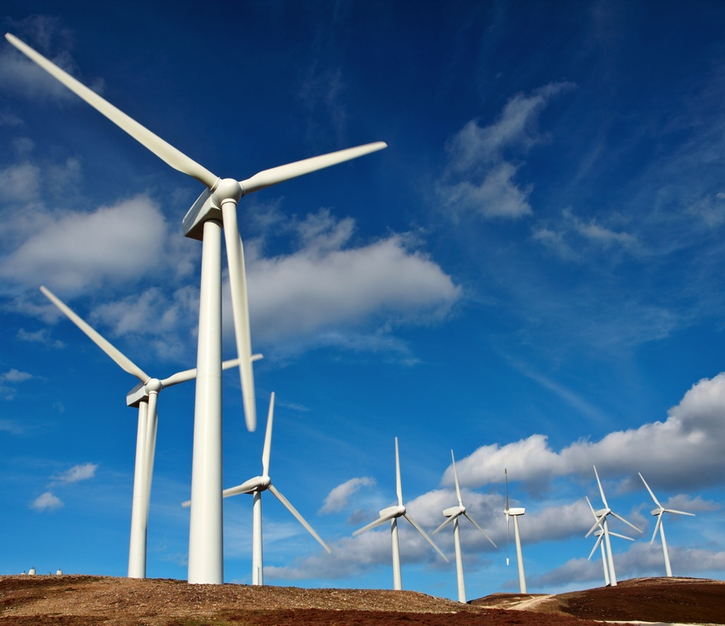
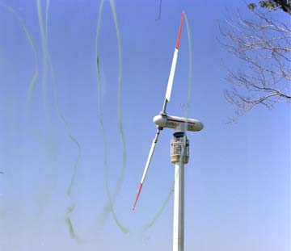
HAWT

Slide 4
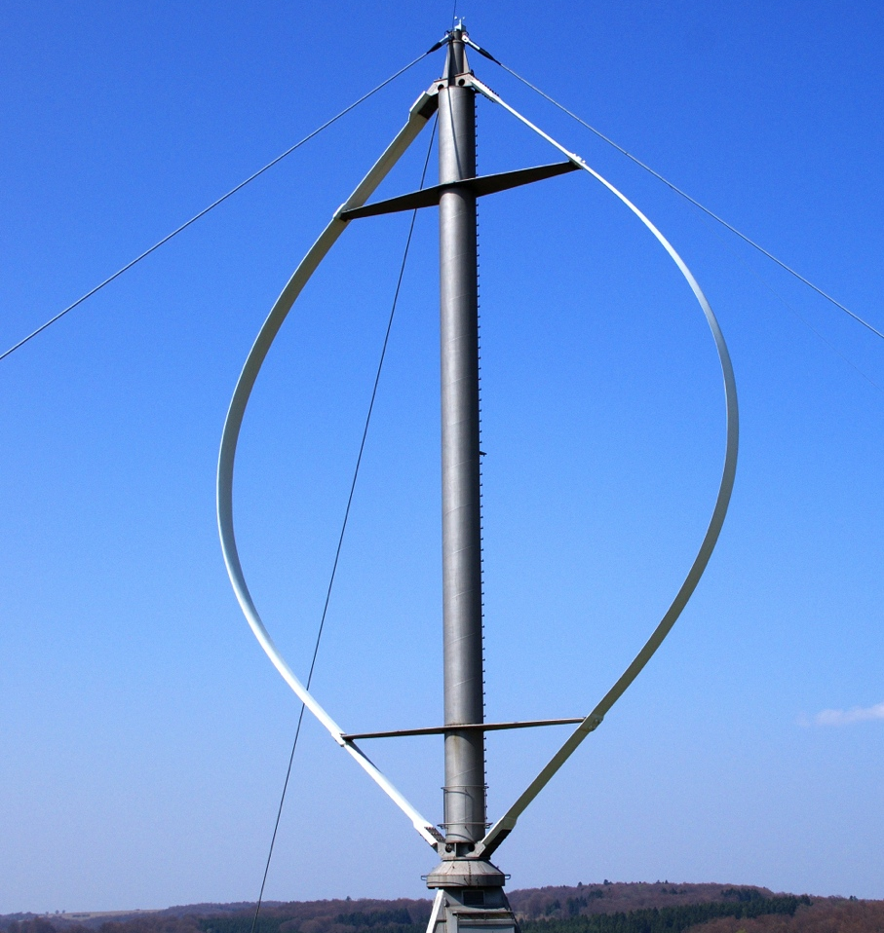
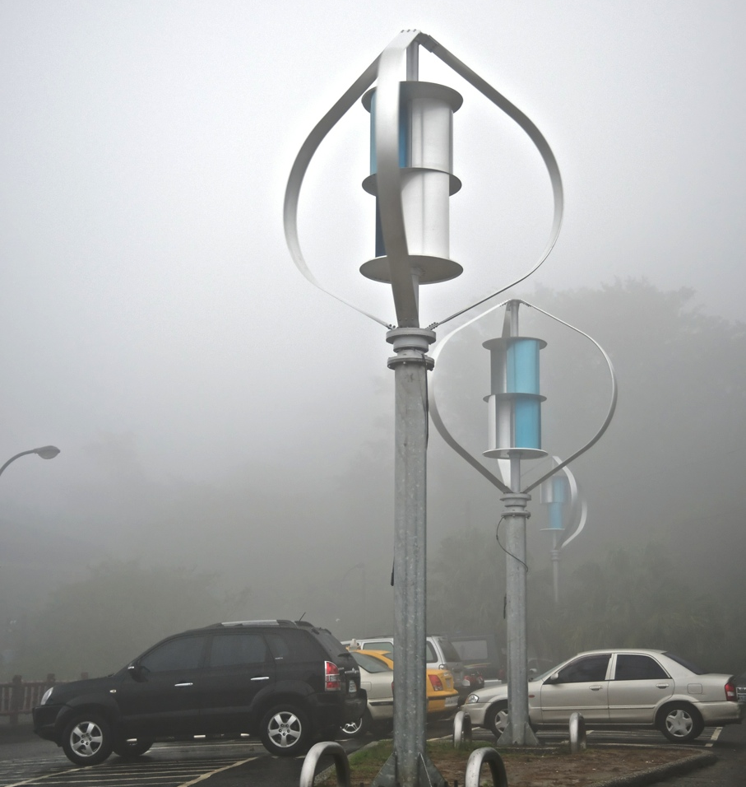
VAWT

Slide 5
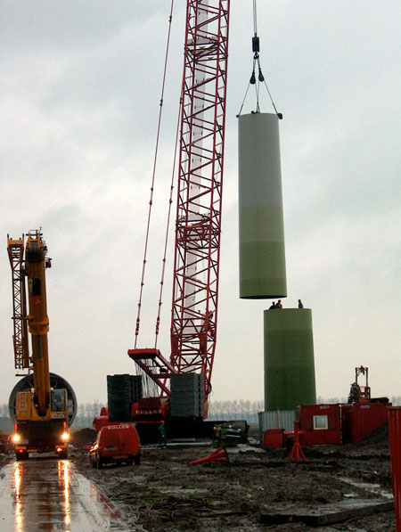
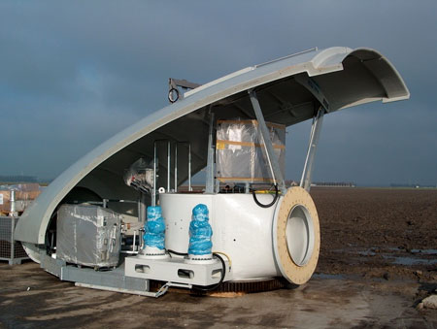
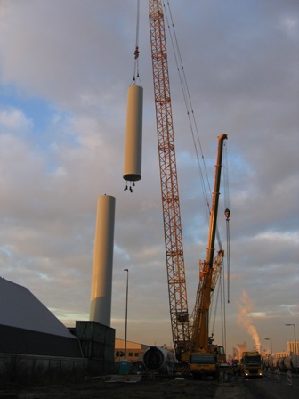
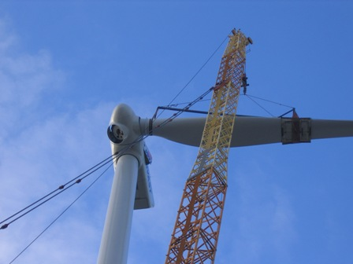
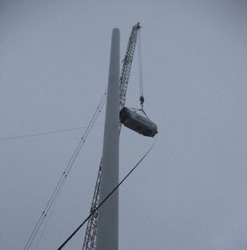
How is a wind turbine built?

Slide 6
What are wind turbines made of?
3-blade HAWT: metal or concrete
  Rotorblades: epoxy resin
VAWT: it differs

Slide 7
What are the criteria a wind turbine has to meet?
several rules and standards
  Construction
  Maintainance
  Achievement
  Grid connection
Certification is possible, by appointed companies only
Standards not binding, yet convenient
Standards more elaborate than legislation

Slide 8
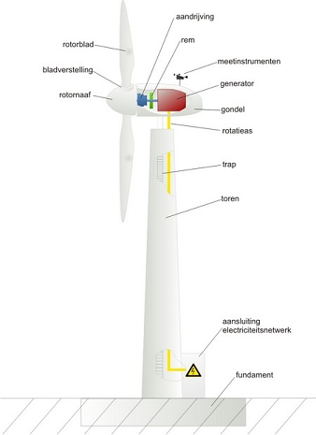
How is wind converted into energy?
drive
rotor blade
brake
Mostly three rotor blades
for energy rotor blades at an angle with the wind direction
Capstan motor turns when necessary
gauges
blade adjustment
rotor hub
generator
gondola
rotating axis
stairs
tower
grid connection
foundation

Slide 9
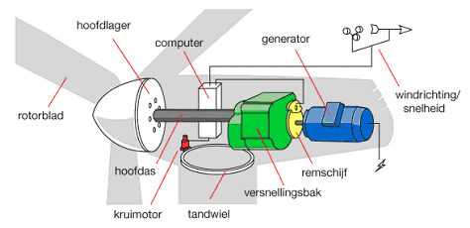
How is wind converted into energy?
main bearing
Most devices in gondola
Gearbox increases speed
  Sometimes left out
Generator
  Works similar to a dynamo
  Axis rotates within stator
    Contains spools of copper wire
  Copper wire delivers electrial current
computer
generator
wind direction/
speed
rotor blade
main axis
brake disc
gearbox
capstan motor
gearwheel

Slide 10
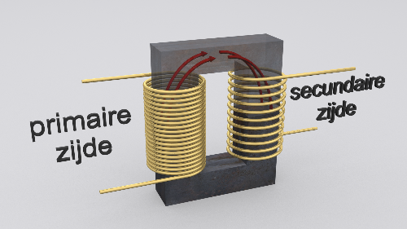
How is wind converted into energy?
Output tension 650 V
Transformed up to 3 to 50 kV
Transformer
  2 spools
  Number of turns determines tension
  2 x more turns on secundary side → 2x more tension
  Magnetic field
secundary
side
primairy
side

Slide 11
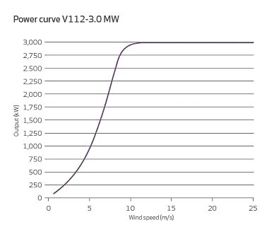
Under what conditions do wind turbines produce energy?
Sufficient wind

Slide 12
How is energy transported?
Connected to the local grid
Correct tension
  Transformer station
  Avoid distortion power
Current flows into the grid

Slide 13
What is the energy yield?
Depends on type of wind turbine
Subject to:
  design
  height
  length of rotor blades
  windspeed
  location
VAWT suitable for urban areas

Slide 14
What is the energy yield?

Slide 15
Movie!!
http://youtu.be/0lyxZcaHlng

Slide 16
Sources
http://www.windenergie.nl/onderwerpen/techniek/veiligheidseisen
http://www.windenergie.nl/onderwerpen/wet-en-regelgeving/normen-en-certificaten
http://www.windenergie.nl/onderwerpen/techniek/opbrengst
http://www.windenergie.nl/onderwerpen/techniek/elektriciteitsnet
http://www.windenergie.nl/onderwerpen/techniek/werking
http://www.energiekeuzes.nl/windturbine/generator/
http://profielwerkstukwindmolens.awardspace.com/?page=onderdelen
http://www.duurzaambouwloket.nl/maatregelen-windenergie-12-energie-2-4.html
http://statline.cbs.nl/StatWeb/publication/?DM=SLNL&PA=70802ned&D1=0,5-6&D2=a&D3=135,152-155,157-159,161-163,165-167,169-172,174-176,178-180,182&HDR=T,G1&STB=G2&VW=T

Slide 17
Sources
http://www.nibud.nl/uitgaven/huishouden/gas-elektriciteit-en-water.html
http://www.winvast.nl/dintelhaven-turbine.html
http://www.windparksvdw.nl/index.php?option=com_content&view=article&id=53&Itemid=63
http://upload.wikimedia.org/wikipedia/commons/9/9f/NASA_MOD-0_smoke_test_1982_05937L.jpg
http://www.debeterewereld.nl/Artikelen/4274/SAMEN_JE_EIGEN_STROOM_OPWEKKEN
http://upload.wikimedia.org/wikipedia/commons/9/92/Darrieus_rotor002.jpg
http://upload.wikimedia.org/wikipedia/commons/f/f7/Taiwan_2009_JinGuaShi_Historic_Gold_Mine_Combined_Darrieus_Savonius_Wind_Turbines_FRD_8638.jpg

